Slide 1
Inheritance in Python
DVT101 – Lecture 38
- By Dataverse Tutorials

Slide 2
What is Inheritance in Python?
Definition of inheritance in OOP
Parent class vs Child class
Relationship between classes
Why inheritance is called “IS-A” relationship

Slide 3
Why Inheritance is Important
Code reusability
Reduces duplication
Real-world modeling
Easier maintenance
Scalable software design

Slide 4
Real World Analogy
Animal → Dog → Puppy
Person → Employee → Manager
Features flowing from parent to child
Behavioral specialization

Slide 5
Core Terminology
Parent class (Base class)
Child class (Derived class)
Attribute inheritance
Method inheritance
Method overriding

Slide 6
How Inheritance Works Internally
Object memory sharing concept
Attribute lookup chain
Method Resolution Order (MRO) idea
Parent search before child

Slide 7
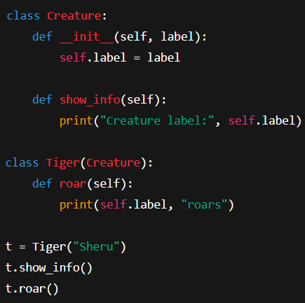
Simple Parent–Child Class Concept
Parent defines common behavior
Child reuses parent logic
Child adds new behavior
Child can override parent behavior

Slide 8
Using Parent Methods in Child
Calling parent methods
Reusing existing logic
Avoiding code repetition
Controlled extension of behavior

Slide 9
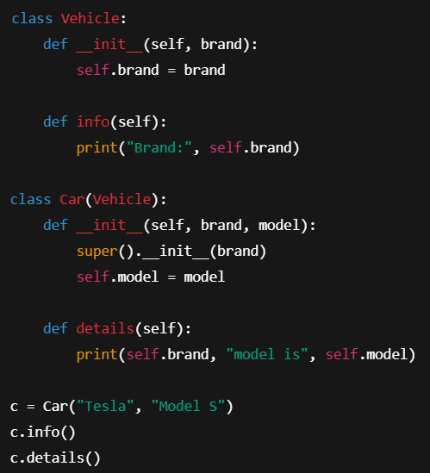
super() Function Concept
Why direct parent calls are risky
How super() safely connects parent
Constructor chaining
Clean inheritance hierarchy

Slide 10
Types of Inheritance in Python
Single
Multiple
Multilevel
Hierarchical
Hybrid

Slide 11
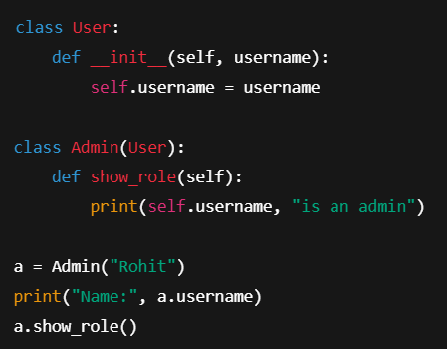
Single Inheritance
One parent → one child
Simple hierarchy
Clean structure
Most common type

Slide 12
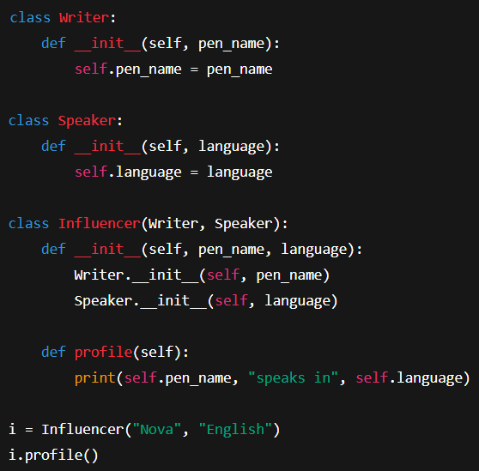
Multiple Inheritance
More than one parent
Shared features from many sources
Diamond problem concept
MRO importance

Slide 13
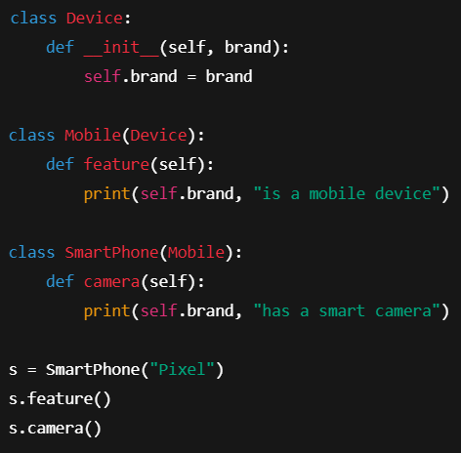
Multilevel & Hierarchical
Multilevel: chain structure
Hierarchical: one parent, many children
Shared root behavior
Specialized child behavior

Slide 14
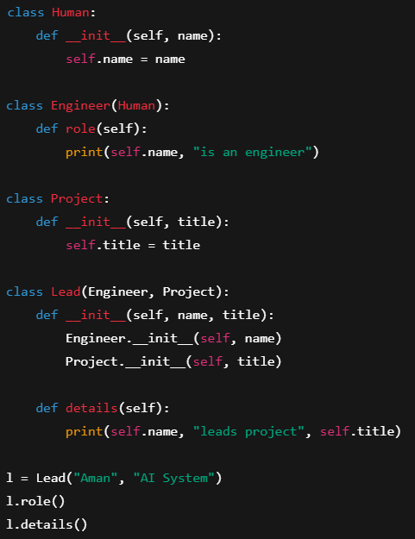
Hybrid Inheritance
Combination of multiple types
Real-world system modeling
Complex class relationships
Requires careful design

Slide 15
Industry Use Cases
Game character hierarchies
Banking systems
Employee management systems
Machine learning pipelines
Framework architecture

Slide 16
Summary & Key Takeaways
Inheritance reduces duplication
Encourages modular design
Supports real-world mapping
Enables scalable architecture

Slide 17


